Slide 1
Forward kinematics
&
inverse kinematics

Slide 2
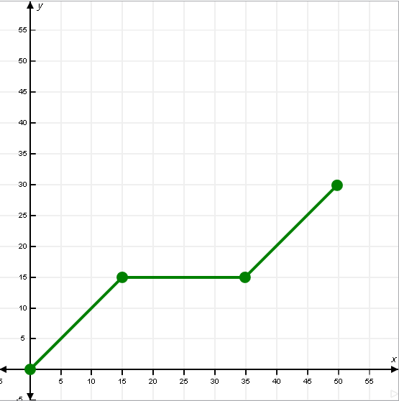






Inverse kinematics
Given information
X= 50
Y= 30
(50, 30)
L3
$$θ2$$
L2
$$θ3$$
L1
$$θ4$$
$$θ5$$
$θ$1

Slide 3
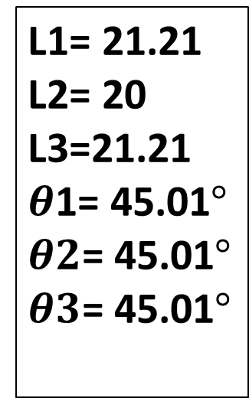
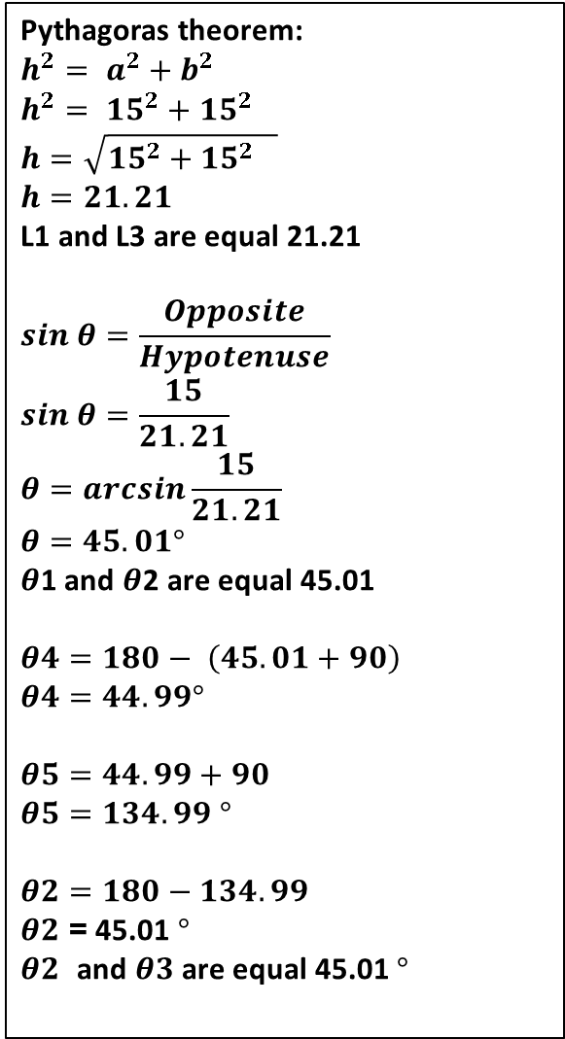
Pythagoras theorem:
$h^{2}= a^{2}+b^{2}$
$h^{2}= {15}^{2}+{15}^{2}$
$$h=\sqrt{{15}^{2}+{15}^{2} }$$
$$h=21.21$$
L1 and L3 are equal 21.21
$$sin θ=\frac{Opposite}{Hypotenuse}$$
$$sin θ=\frac{15}{21.21}$$
$$θ=arcsin\frac{15}{21.21}$$
$$θ=45.01°$$
$θ$1 and $θ$2 are equal 45.01
$$θ4=180− \left(45.01+90\right)$$
$$θ4=44.99°$$
$$θ5=44.99+90$$
$θ5=134.99$ $°$
$$θ2=180−134.99$$
$θ2$= 45.01 $°$
$θ2$ and $θ3$are equal 45.01 $°$
The solution
L1= 21.21
L2= 20
L3=21.21
$θ$1= 45.01$°$
$θ2$= 45.01$°$
$θ3$= 45.01$°$
(50, 30)
21.21
15
45.01°
𝟒𝟓.𝟎𝟏°
20
15
21.21
135.01°
44.99°
15
15
45.01°
15

Slide 4
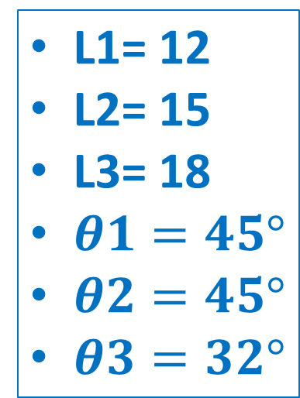



Forward kinematics:
Given information
L1= 12
L2= 15
L3= 18
$θ1=45°$
$θ2=45°$
$θ3=32°$
18
4$5°$
15
3$2°$
12
45$°$

Slide 5






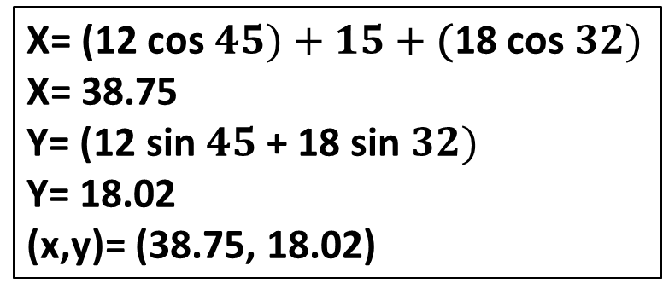





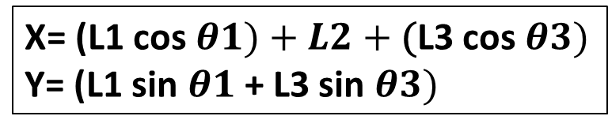
The solution
Y
X= (L1 cos $θ1)+L2+\text{(}\text{L}\text{3 }\text{cos} θ3)$
Y= (L1 sin $θ1$+ L3 sin $θ3)$
L1 cos $θ1$
15
L3 cos $θ3$
X= (12 cos $45)+15+\text{(}\text{18} \text{cos} 32)$
X= 38.75
Y= (12 sin $45$+ 18 sin $32)$
Y= 18.02
(x,y)= (38.75, 18.02)
18
L3 sin $θ3$
58$°$
4$5°$
15
3$2°$
L3 cos $θ3$
12
L1 sin $θ1$
L1 sin $θ1$
45$°$
X
L1 cos $θ1$

